Slide 1

Capstone Review-II
Guide:
Mrs. Vinaya Tapkir
Name: Santosh Hatte
Exam Seat No.: B226011
PRN: 0120190436
Final Year BTECH (ETX)

Slide 2

Problem Statement:
General Capstone:
Design a technical blog
Discussion about the algorithms, technologies.
Platform Used:
Link for the Blogs:
https://medium.com/@hattesantosh1999

Slide 3
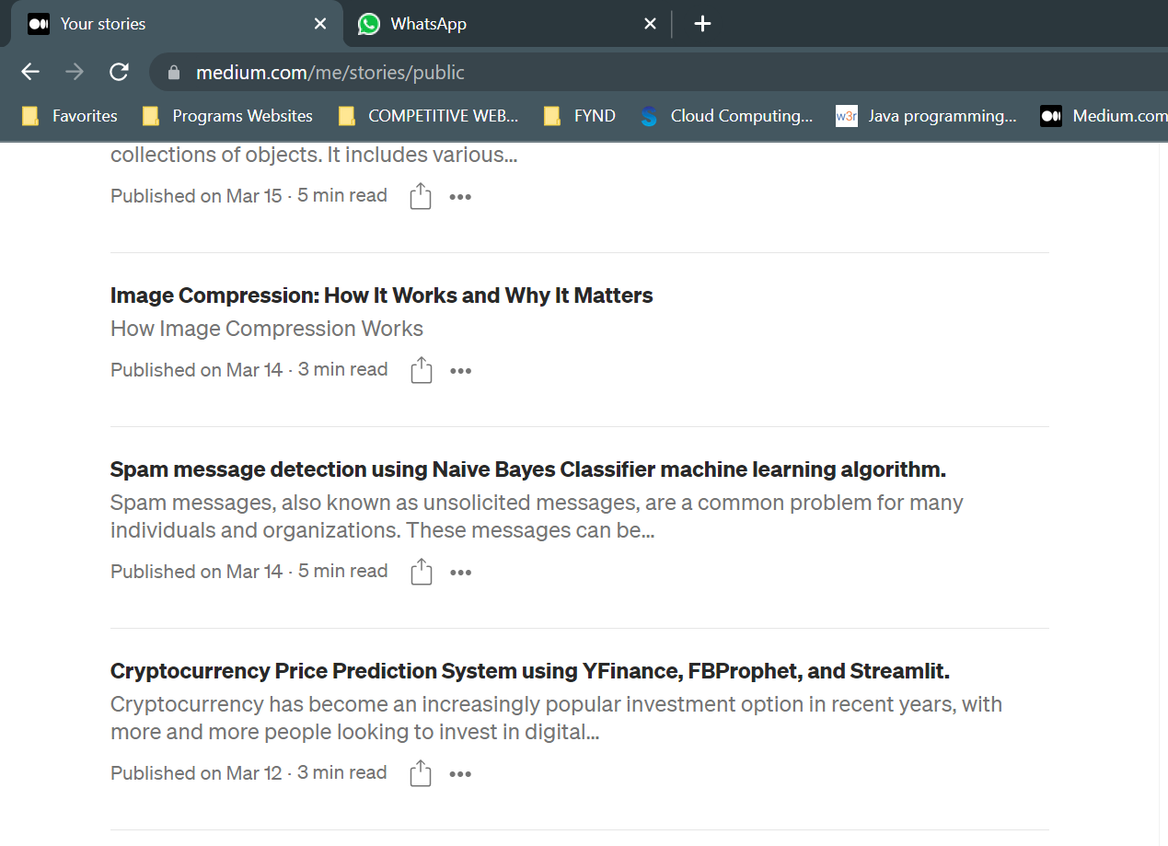
Published Blogs:

Slide 4
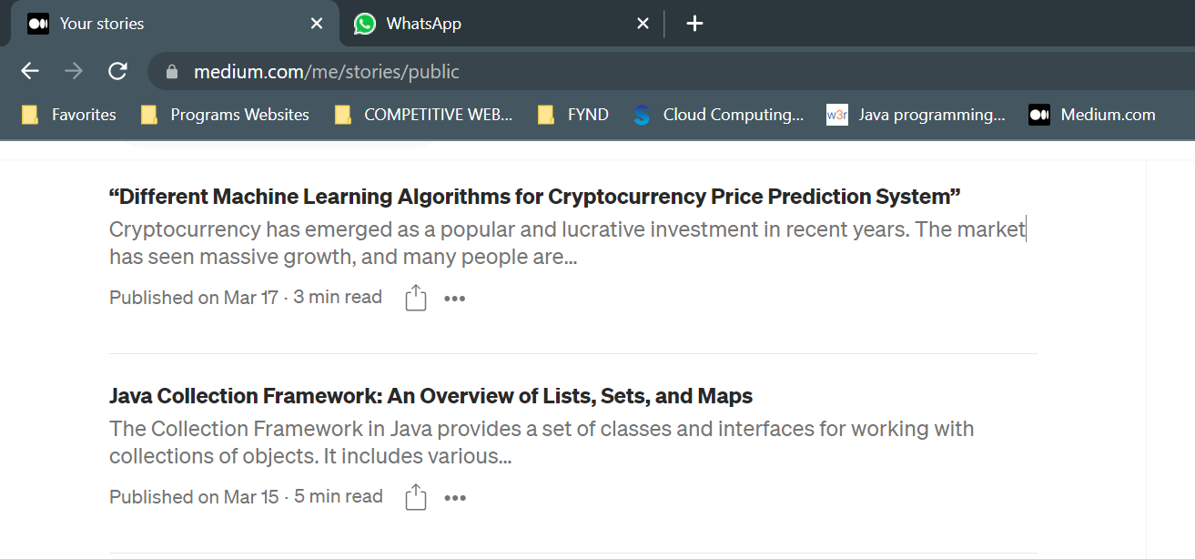
Published Blogs:

Slide 5
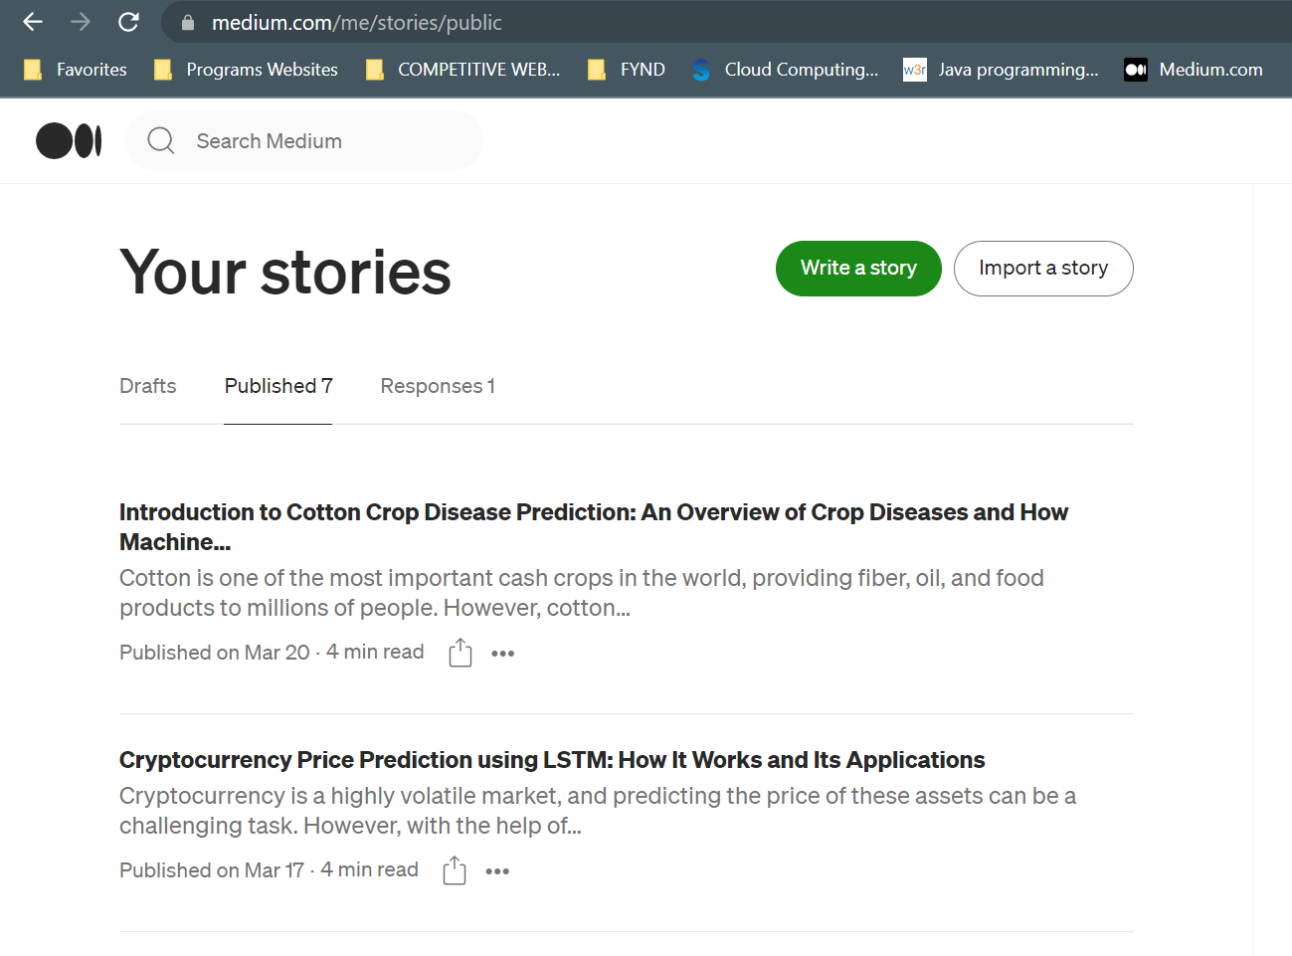
Published Blogs:

Slide 6
Conclusion:
These blog will explore the various methods, technologies and algorithms used.
Implementation of a cryptocurrency price prediction system using machine learning algorithms and how this system can be used to make informed investment decisions.
The blog posts will be an informative and educational resource for anyone.

Slide 7



